Slide 1
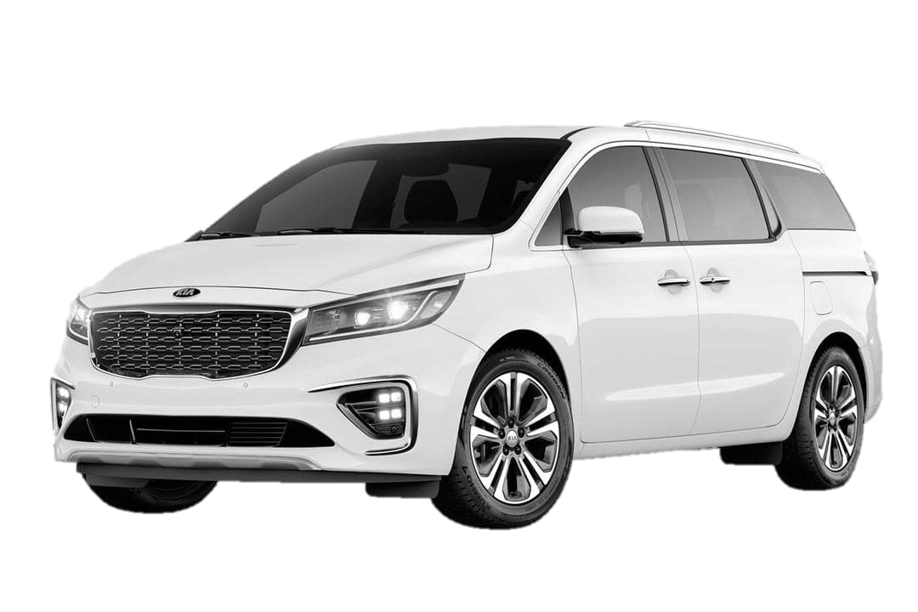
New car Project Proposal

Slide 2
Target consumer
Young people
Family
Employees
Elderly

Slide 3
Benefits for parents
Roomy
Economical
Safety
Accomodates 5 people and staff
Fuel-efficiency, minimal maintenance & durable
Airbags, anti-lock brakes & cameras

Slide 4
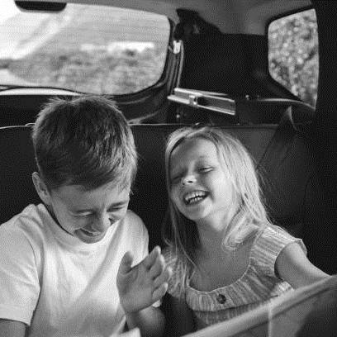
Benefits for children
Necessary entertainment systems: Bluetooth connectivity & touchscreen systems

Slide 5
Easy control
Understandable & comfortable
AutoPilot

Slide 6
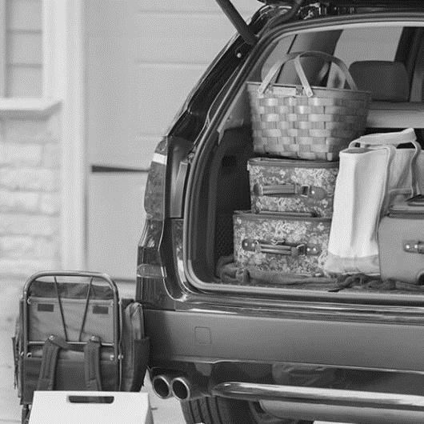
Spacious
A lot of storage space for every family member

Slide 7
Summing up
Reliable
Comfortable
Safe

Slide 8
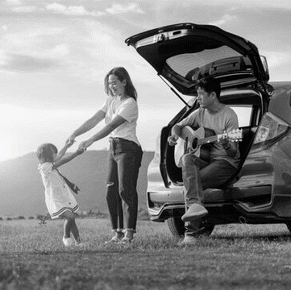
Ride with comfort & with us!

